Slide 1
Visual Summarization of Web Pages
Binxing Jiao et. al (SIGIR ’10)
Presenter : Lin, Yi-Jhen
Advisor: Dr. Koh. Jia-ling
Date: 2011/4/25

Slide 2
Outline
Introduction
Internal image based visual summarization
Visual Snippet
External image based visual summarization
Experimental results
User study
Conclusion

Slide 3
Introduction
Search and re-finding tasks are among the most typical applications on the Internet.
Information search and re-finding tasks would become more efficient if the web pages are visually summarized.

Slide 4
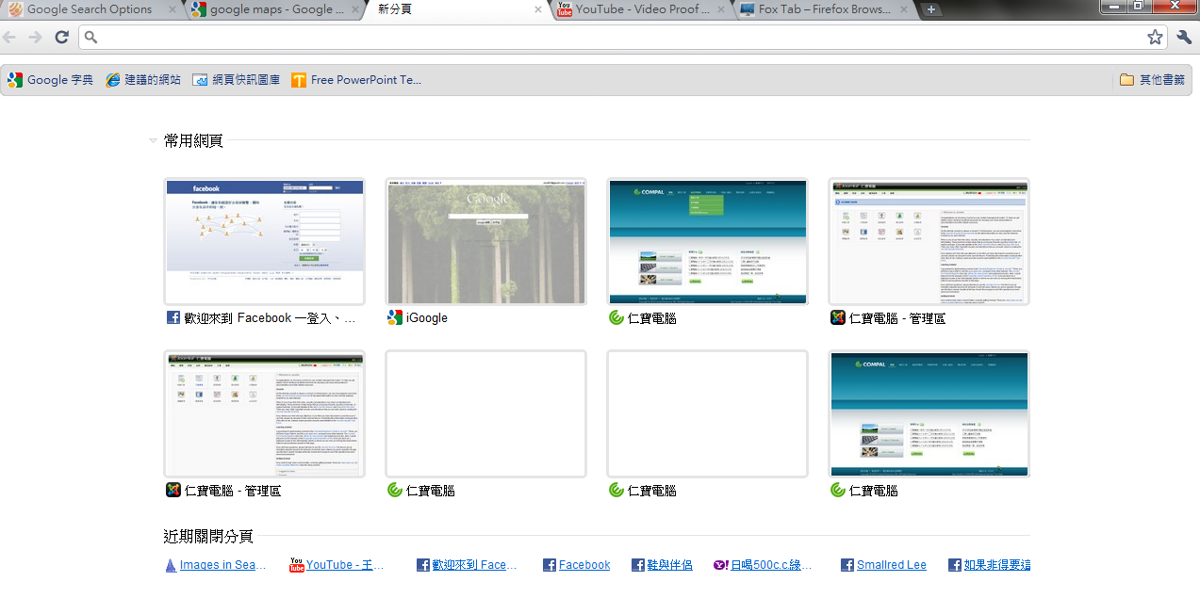
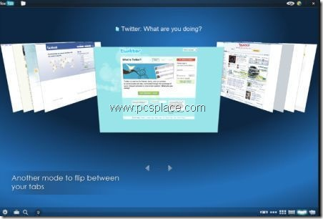
Introduction cont.
Thumbnails
Sites with images

Slide 5
Introduction cont.
Difficulties of internal image based visual summarization
For those web pages which have complex layout or rich content, users are difficult to see clearly from the small thumbnails.
Internal images are unavailable for a large amount of web pages which do not contain useful images.
We propose to mine images from the external, which is so-called external image based visual summarization.
We investigate the applicability of the different visual summarization approaches to different kinds of web pages and for different tasks including search and re-finding. The different approaches including:
Thumbnails
Internal images
External images
Visual snippet

Slide 6
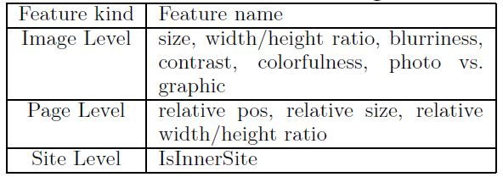
Internal image based visual summarization
The images contained in a web page are usually used to describe the content of the page, which are so-called internal images and can be directly used to summarize the web page.
We need to detect the most dominant among all the images in a web page for visually summarization.
Extract features
Labeled training data
Ranking-SVM
Labeled as ($x_{i,j},y_{i,j}$)
$x_{i,j}$ : extracted feature vector of image i in page j
$y_{i,j}$ : labeled dominance
0 (useless) / 1 (important) / 2 (highly important)

Slide 7
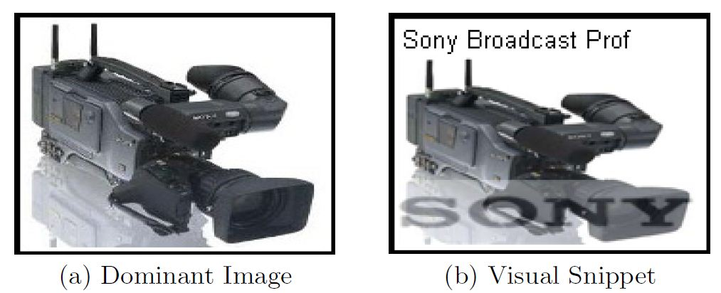
Visual snippet
Visual snippet enriches internal dominant images by synthesizing the salient text (e.g., title), dominant image, and logo into a single image.
Internal dominant image selection and processing
Logo extraction
Title extraction
Image Composition
Detected by a trained model
Image’s location in the page
Size
Name
Surrounding text
Extracted from the html source of web page
The first 19 characters of the title are cropped

Slide 8
External image based visual summarization

Slide 9
Key phrase extraction
External image based visual summarization cont.
We employ the KEX algorithm to extract the key phrases.
In KEX, a model is trained by logistic regression, and can be used to calculate the salience score of each candidate phrase.
The top 4 key phrases are used as queries to the image search engine.
For each key phrase, 30 results including images and corresponding web pages are retrieved for further processing.

Slide 10
Image Ranking and Filtering
External image based visual summarization cont.
Rerank result images
Based on the textual similarities between the web pages containing the images and the target web page.
TFIDF --> cosine similarity
Filter images
Visual importance of result images is calculated using VisualRank
The images whose importance score is below a threshold will be filtered out

Slide 11
Image Ranking and Filtering cont.
External image based visual summarization cont.
VisualRank
Extract local SIFT features for each image
Similarity(img i, img j) : the # of local features shared between them divided by the average # of local features in img i, img j
A graph is constructed with images as vertices and visual similarities as weights on edges
PageRank is applied on the graph and then the resulted rank score vector is employed to represent the importance of each image

Slide 12
Experiment setup
Experimental Results
100 queries from KDD CUP 2005
Use Bing Search API to retrieve top 100 search results for each of queries.
8412 retrieved web pages was obtained
Download all of internal images and retrieved external images.
Expert labelers annotate whether the internal images were dominant and the external images were relevant to summarize the corresponding web page.

Slide 13
Experiment setup cont.
Experimental Results
DIP : Web pages with at least on internal image annotated as dominant
NDIP : without any dominant internal image annotated
41.8% of web pages are NDIPs in our data set.
Labelers judge which summary is the best to represent the web page.
He/she can select “others”.

Slide 14
Usefulness of external images
Experimental Results cont.
External images can be considered as a useful source for web page summarization.
Web pages containing dominant images can be regarded as more appropriate for visual summarization, which, hence, can also be summarized well by a relevant image retrieved from the external.
The external images are valuable complement to internal images for visual summarization of web pages.

Slide 15
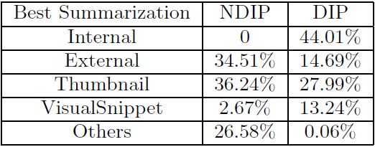
Comparison of various visual summaries
Experimental Results cont.
Dominant Image and Visual Snippet as the best summarization
Thumbnail as the best summarization
External Image as the best summarization

Slide 16
Comparison of various visual summaries cont.
Experimental Results cont.
Dominant Image and Visual Snippet as the best summarization
Dominant image based summarizations are the best summarization for over a half DIPs.
For DIP, the visual snippet is worse than the dominant image.
Title information is misread
Visual snippet is rough-and-tumble.

Slide 17
Comparison of various visual summaries cont.
Experimental Results cont.
Thumbnail as the best summarization
categorize these pages into
pages in small size
pages with several images
Pages with salient and clear image/text
Pages With logo
Pages With simple page structure
Pages in well-known web site
With logo
Well-known web site
With salient and clear image/text

Slide 18
Comparison of various visual summaries cont.
Experimental Results cont.
External Image as the best summarization
For NDIPs, external images with tremendous relevance score can be adopted as reliable summarizations
Otherwise, thumbnails are better, especially for “pages with logo” and “pages in well-known web site”.

Slide 19
Comparison of various visual summaries cont.
Experimental Results cont.
Summary – guidance of selecting summarization type
For NDIP
External images are useful, but suffer from reliability problem.
Thumbnail are also good, especially for “pages with logo” and “pages in well-known web site”.
For DIP
If the dominant images are contained and can be recognized in the thumbnail, thumbnail is the best choice; otherwise dominant images are more reliable.
If an exclusive dominant image is found and the title information agrees with the content of the dominant image, visual snippet is better than a single dominant image.

Slide 20
User study
The goal of this study is to explore how different summarization approaches support a understanding or a re-finding task.
51 participants
Bachelor’s degree at least
20-35 years old
56% male, 44% female
Heavy web users
11 web pages are chosen from a range of different categories
9 DIP / 2 NDIP

Slide 21
User study cont.
Phrase 1 -- understanding
Each participant was given a web page and one of four visual summaries
Step 1 : guess the content of the web page based solely on the provided visual summarization
Step 2 : read the web page and to rate a score ranging from -1 to 3
-1 : the summarization misleads the participant
0 : participant can not understanding the summarization
1 : the summarization can help users grasp a rough idea on what the page is about
3 : the summarization can help users exactly understanding the content of the web page
2 : the between of 1 and 3

Slide 22
User study cont.
Phrase 2 -- re-finding
We explored how the various summarizations types would affect the recall of the web pages visited in phrase 1.
we specify a web page to be re-found, the participants were asked to select an image, which can remind them of the web page.
To evaluate the performance of each summarization type for this phrase, we define the error rate of a summarization type (e(s)) as
I{ } : an indicator , 1 or 0

Slide 23
Results and discussion
User study cont.
Understanding Task
For DIP
For NDIP

Slide 24
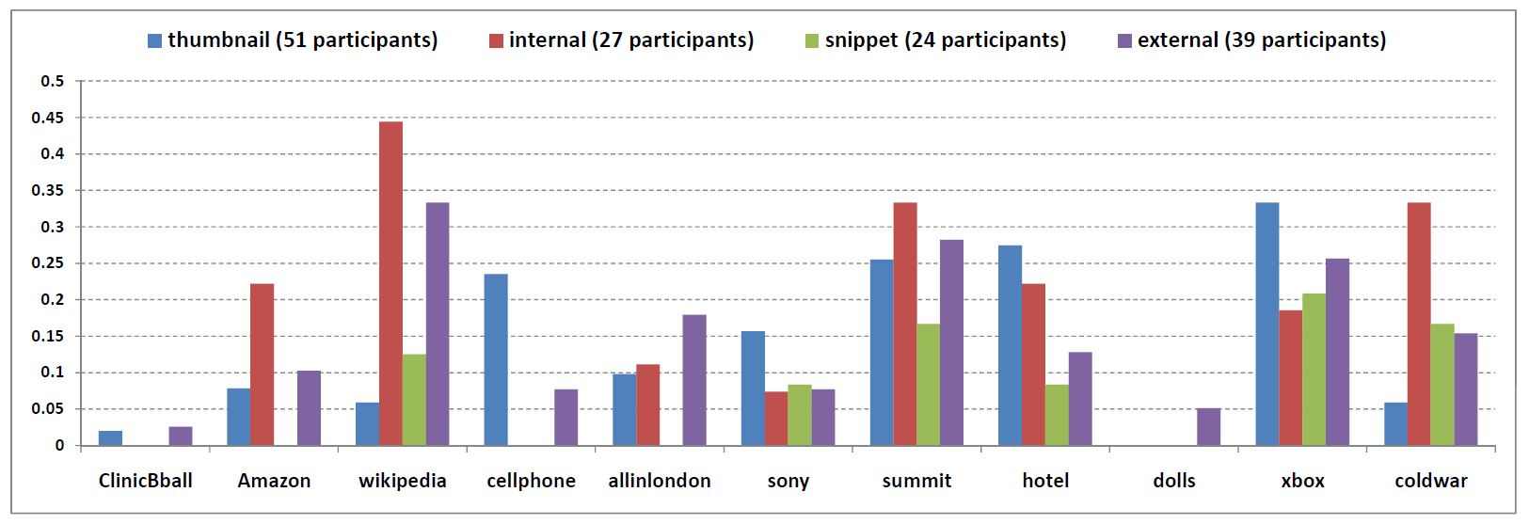
Results and discussion cont.
User study cont.
Re-finding Task

Slide 25
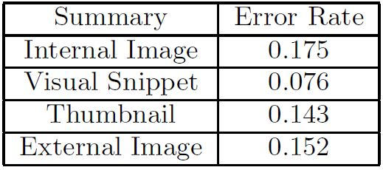
Results and discussion cont.
User study cont.
Re-finding Task
The visual snippet performs better than other summarizations.
The additional two components of the visual snippet : Title and logo information are useful for identifying different visited web pages.

Slide 26
Results and discussion cont.
User study cont.
Thumbnail worse than visual snippet
Thumbnail is good
Re-finding Task
External image based summarization is not suitable for re-finding task

Slide 27
Conclusion
An external image based visual summarization is proposed, which selects the representative images from the entire Internet.
We present a careful study on comparing the various visual summarization method for web pages.
The various summarization approaches have respective advantages on different types of web pages and for different tasks.
Thumbnails are simple and effective for web pages with simple structure or clear image and text with large size
Internal images can summarize the web page well if it includes dominant images
External images are useful for those web pages without dominant images
Visual snippets are effective in helping users identifying the visited web pages in the re-finding task

